Slide 1
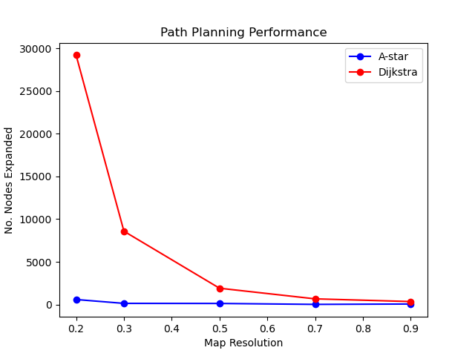
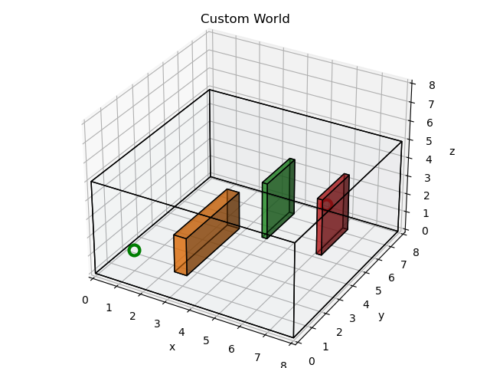
Observe that as the map resolution increases, we expand less nodes and the difference between A-star and Dijkstra diminishes as the map resolution increases. Another observation not shown in the plots is that the competition time of the algorithm takes significantly longer as the map resolution decreases. This makes sense. When we discretize the configuration space this results in more nodes for the algorithm to explore, further increasing completion time. This effect is apparent in both A-star and Dijkstra. Also, given that Dijkstra does not employ the use of a heuristic to bias node exploration towards the goal, it is interesting to observe that at a map resolution approaching 1.0, the differences we see in the number of nodes expanded virtually vanish which, is sensible. We can imagine some critical resolution value such that A-star and Dijsktra perform similarly for any given map. Ultimately, algorithm performance is limited by the ways in which the configuration space is partitioned.
Ikenna Achilihu
MEAM 620 Spring 2021

